Slide 1
EDA PROJECT USING LAYOFFS DATASET

Slide 2

overview
Introduction
Challenges in dataset
EDA Process
Conclusion

Slide 3
INTRODUCTION
In today’s rapidly evolving job market, workforce layoffs have become a critical topic of analysis. Understanding the patterns, trends, and factors influencing layoffs can provide valuable insights for businesses, policymakers, and job seekers. This project aims to perform Exploratory Data Analysis (EDA) on a layoffs dataset using SQL to uncover key trends and patterns in employment cuts across different industries, companies, and time periods.

Slide 4
Challenges In dataset
While performing Eda process There are different type of challenges that will effect insight generation and proper analysis:
Data Quality Issues
Handling Unstructured or Categorical Data
Handling Large dataset Efficiently
Time – series challenges
Recursive Queries for Hierarchial Data

Slide 5
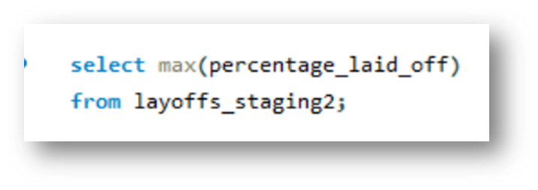
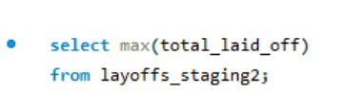
EDA Process
First, check how layoffs were conducted by analyzing each column and reviewing the data. Identify the maximum number of layoffs recorded , And the maximum percentage of layoffs in the dataset :

Slide 6
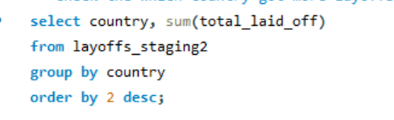
Analysis of layoffs across different countries based on total layoffs reported :

Slide 7
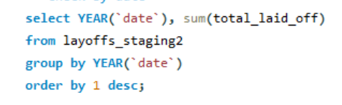
Trend analysis of layoffs recorded by date to observe patterns over time :

Slide 8
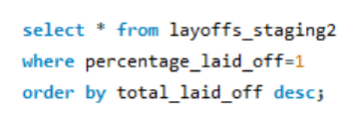
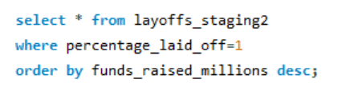
Perform some analysis of the highest percentage of layoffs :-

Slide 9
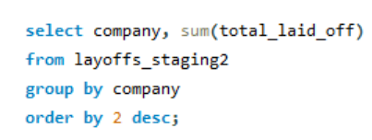
Analysis of layoffs of different company based on total layoffs reported :

Slide 10
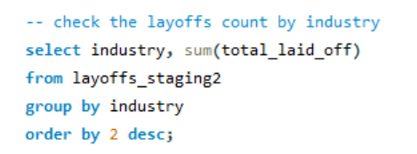
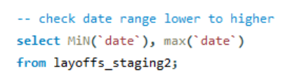
Analysis of layoffs across different industry based on total layoffs reported and date range from lower to higher :-

Slide 11
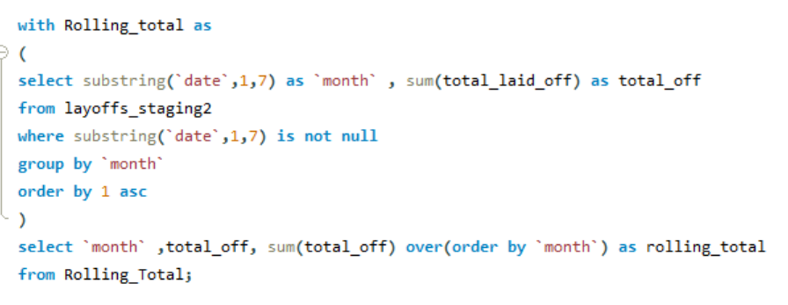
Do some deep analysis based on your query result using cte an dcreate new column named as rolling_Total :-

Slide 12
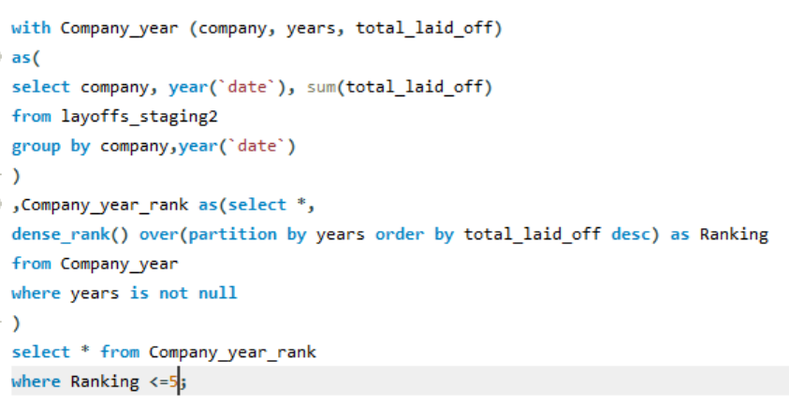
Analyzing the top 5 companies with the highest layoffs per year using CTE and DENSE_RANK.
Utilizing Common Table Expressions (CTE) to rank companies based on annual layoffs, ensuring insights into industry trends.
Filtering top 5 ranked companies by highest layoffs per year using the DENSE_RANK() function for precise ordering.
Aggregating company layoffs year-wise and ranking them based on total layoffs using window functions.
Implementing advanced SQL techniques to identify companies with the most significant layoffs each year.

Slide 13
conclusion
Performed an in-depth analysis of layoffs data by examining every column and identifying trends in layoff counts. Utilized CTEs and various SQL operations to analyze total layoffs, percentage layoffs, and distributions across companies, industries, and countries.

Slide 14

SRIVIDYA!

